Slide 1
A presentation on Movie recommendation system
Submitted To:-
Innomatics Research Labs
Submitted By:-
TEAM 11
MRS94
VINAY KUMAR

Slide 2
What is Recommendation System ?
Recommender systems are the systems that are designed to recommend things to the user based on many different factors. These systems predict the most likely product that the users are most likely to purchase and are of interest to. Companies like Netflix, Amazon, etc. use recommender systems to help their users to identify the correct product or movies for them.
The recommender system deals with a large volume of information present by filtering the most important information based on the data provided by a user and other factors that take care of the user’s preference and interest. It finds out the match between user and item and imputes the similarities between users and items for recommendation.
Both the users and the services provided have benefited from these kinds of systems. The quality and decision-making process has also improved through these kinds of systems.

Slide 3
Why the Recommendation system?
Benefits users in finding items of their interest.
Help item providers in delivering their items to the right user.
Identity products that are most relevant to users.
Personalized content.
Help websites to improve user engagement.

Slide 4
What can be Recommended?
There are many different things that can be recommended by the system like movies, books, news, articles, jobs, advertisements, etc. Netflix uses a recommender system to recommend movies & web-series to its users. Similarly, YouTube recommends different videos. There are many examples of recommender systems that are widely used today.

Slide 5
About the Dataset
The dataset consists of metadata for all 45,000 movies listed in the Full MovieLens Dataset. The dataset consists of movies released on or before July 2017. Data points include cast, crew, plot keywords, budget, revenue, posters, release dates, languages, production companies, countries, TMDB vote counts and vote averages.

Slide 6
Dataset Description
This dataset consists of the following files:
movies_metadata.csv: The main Movies Metadata file. Contains information on 45,000 movies featured in the Full MovieLens dataset. Features include posters, backdrops, budget, revenue, release dates, languages, production countries and companies.
keywords.csv: Contains the movie plot keywords for our MovieLens movies. Available in the form of a stringified JSON Object.
credits.csv: Consists of Cast and Crew Information for all our movies. Available in the form of a stringified JSON Object.
links.csv: The file that contains the TMDB and IMDB IDs of all the movies featured in the Full MovieLens dataset.
links_small.csv: Contains the TMDB and IMDB IDs of a small subset of 9,000 movies of the Full Dataset.
ratings_small.csv: The subset of 100,000 ratings from 700 users on 9,000 movies.

Slide 7
Movie Recommendation System
These recommendation systems have been widely used with two approaches named content based and collaborative filtering algorithm. The proposed system makes use of both the approaches to provide the combined algorithm which takes the user query and creates the results as movies that are related. By using the user profile, the hybrid recommendation system combines both content based and collaborative filtering algorithms that predict the users interested movies.
The movie dataset is divided into training and testing data sets where the recommendation model is applied on the testing set to find the predictions. As part of the Content based filtering the item features are taken to predict the items related to user’s query. The item features that are considered for the proposed system are the movie genres and ratings. In collaborative filtering process, the system uses the cosine similarity metric to find the distance between one user to other users. This approach overcomes the problem of cold start by using content based approach and handling data sparsity by selecting features.
By combining both the recommendation algorithms, a hybrid approach is generated which provides more accurate results. This hybrid recommendation system finally recommends the set of movies that are relevant to the users interest.

Slide 8
Types of Recommendation System
1. Popularity-Based Recommendation System
It is a type of recommendation system which works on the principle of popularity and or anything which is in trend. These systems check about the product or movie which are in trend or are most popular among the users and directly recommend those.
For example, if a product is often purchased by most people then the system will get to know that that product is most popular so for every new user who just signed it, the system will recommend that product to that user also and chances becomes high that the new user will also purchase that.
Example
Google News: News filtered by trending and most popular news.
YouTube: Trending videos.

Slide 9
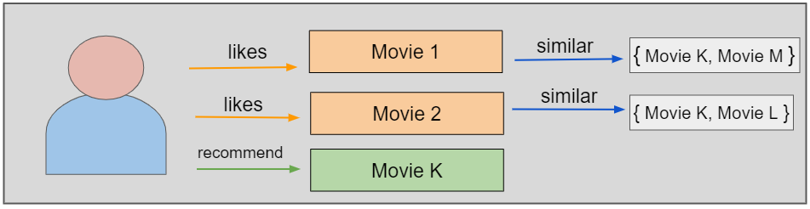
Types of Recommendation System
2. Content-Based Recommendation System
It is another type of recommendation system which works on the principle of similar content. If a user is watching a movie, then the system will check about other movies of similar content or the same genre of the movie the user is watching. There are various fundamentals attributes that are used to compute the similarity while checking about similar content.

Slide 10
Types of Recommendation System
3. Collaborative Filtering
It is considered to be one of the very smart recommender systems that work on the similarity between different users and also items that are widely used as an e-commerce website and also online movie websites. It checks about the taste of similar users and does recommendations.
The similarity is not restricted to the taste of the user moreover there can be consideration of similarity between different items also. The system will give more efficient recommendations if we have a large volume of information about users and items.

Slide 11
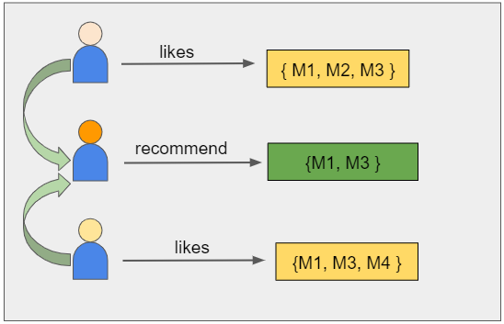
Types of Recommendation System
3. Collaborative Filtering
For example, if user A watches M1, M2, and M3, and user B watches M1, M3, M4, we recommend M1 and M3 to a similar user C.

Slide 12
Types of Recommendation System
4.Hybrid recommendations approaches
Most recommender systems now use a hybrid approach, combining collaborative filtering, content-based filtering, and other approaches. There is no reason why several different techniques of the same type could not be hybridized. Hybrid approaches can be implemented in several ways: by making content-based and collaborative-based predictions separately and then combining them; by adding content-based capabilities to a collaborative-based approach (and vice versa).

Slide 13
Project Work Flow
1.
Preprocessing the Data
Performing Exploratory Data Analysis
2.
Implementing Popularity based recommender by considering the weighted average of Vote_values and vote_counts from movies dataset
3.
Implementing Content based recommender by creating tags from overview, Cast, crew and keywords from Movies data , Credits.csv and keywords.csv
Using cosine similarity to find the similarity between movies and make recommendations.

Slide 14
Project Work Flow
4.
Implementing Collaborative filtering by ratings of the other similar users provided in ratings.csv
5.
Implementing Hybrid Recommender
6.
Evaluation and Deployment

Slide 15
Start
Start
Load Movie Database
Load Movie Database
Extract user visit information
Extract user visit information
Content Based filtering
Collaborative Based filtering
Provide recommendation to the user
Provide recommendation to the user
Stop
Stop
Fig. Content Based Filtering
Fig. Collaborative Based Filtering

Slide 16
THANK YOU

